Slide 1
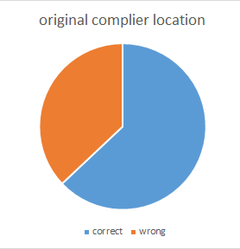
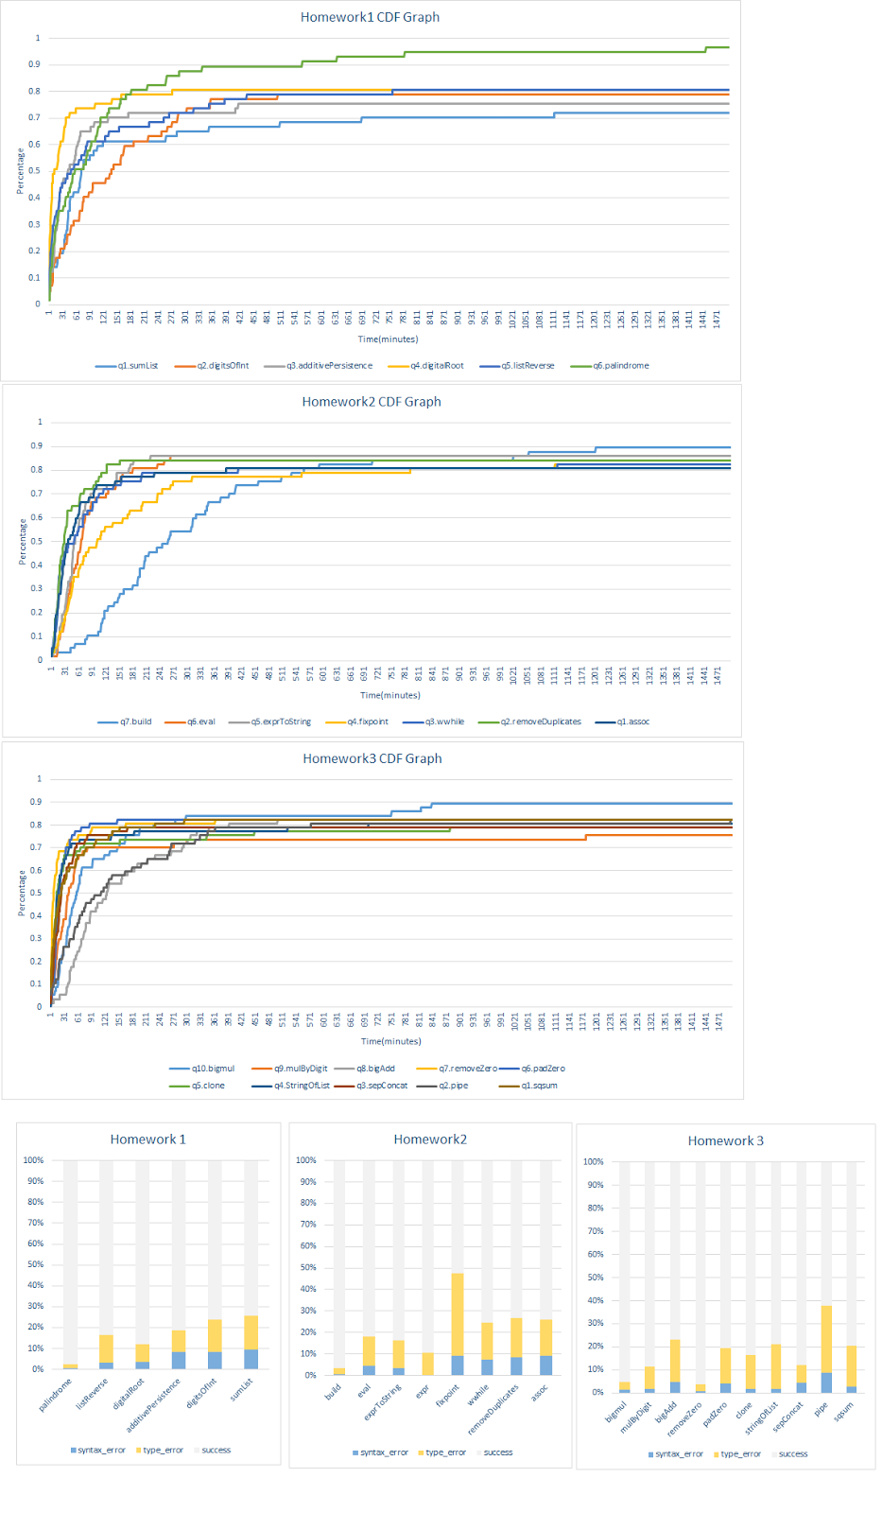
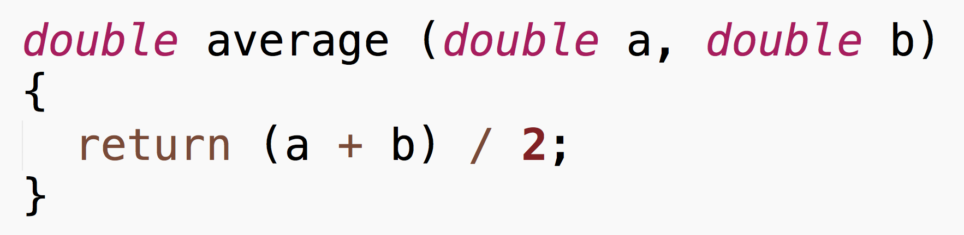
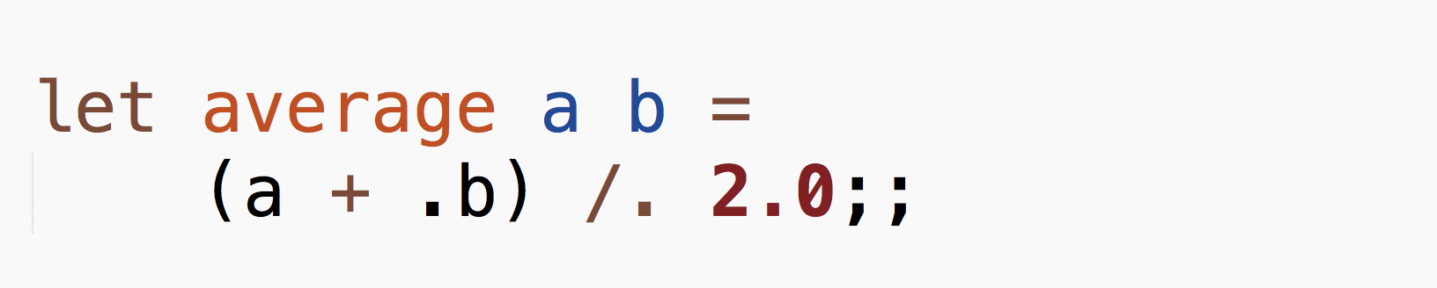
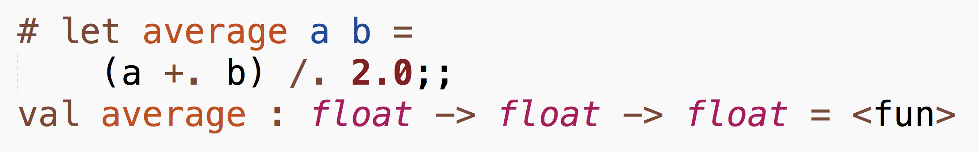
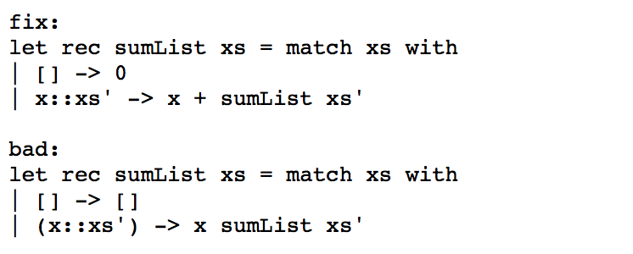
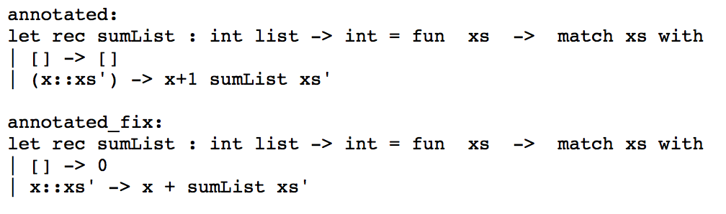
Type Inference from Test Cases
Jiani Huang, Soomin Lee, Yijun Zhang
UCSD CSE Early Research Scholars Program (ERSP)
Problem Statement
Methods
Discussion
It is well-known in community that functional programming languages are challenging, but less is understood about why. Our goal is to understand how beginners learn OCaml and propose a way to make their learning process more efficient
Then we proceeded to see if the actual fixed location matches the error location that compiler outputs and found that the error messages are largely misleading.
From our collected data, we were able to find out that type error was the main issue for the beginners:
From top-level, typing an OCaml function generates its type annotation. It prints out what it thinks are the types of declared function. The general format is:
Background
Syntax difference - Java vs. OCaml:
For example,
After looking at type errors, in order to see how the student’s code changes over time, we tracked the progress of each function, and labeled them as bad-fix pairs:
In order to track students’ progress, we collected data from homework assignments from CSE 130, which included snapshots of their entire file every thirty seconds. Collected as JSON files, they included the following:
Unix timestamp
Body of file
Section of code that was send to compiler
Output error message, if any
And we used this information to annotate each function and its fixed version, to see if this would lead to OCaml compiler outputting more accurate error location:
Initial data analysis was done to see how much time the students spend on each homework problem to find out which concepts they struggle with the most.
Results
Acknowledgements
We would like to thank

